Slide 1
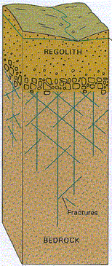

Chapter 15 Weathering and Mass Wasting

Slide 2
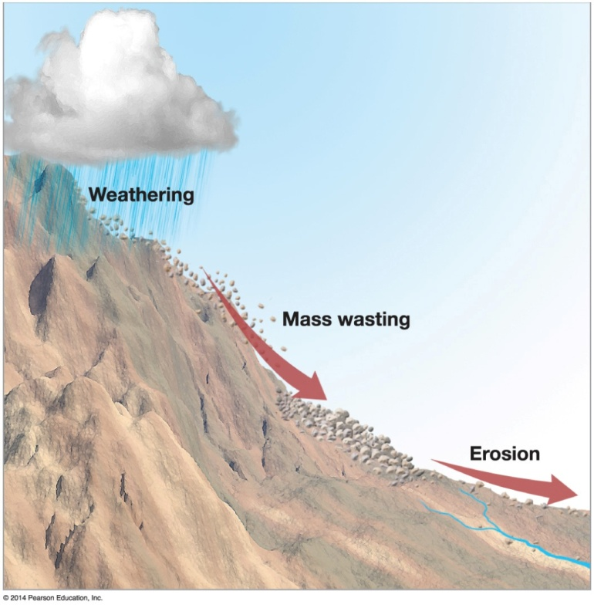

Denudation
Overall effect of distintegration, wearing away, and removal of rock material
Three types of activities:
Weathering- Breaking down
Mass wasting-movement
Erosion=
removal, transport,deposition

Slide 3

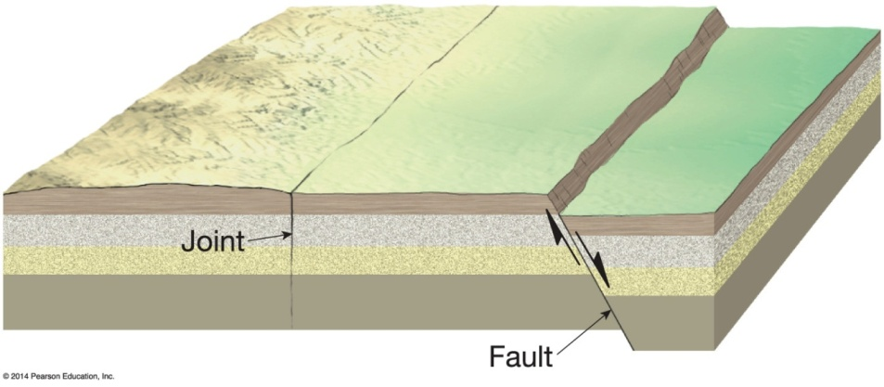

Weathering and Rock Openings
Five types of openings
Microscopic – numerous, occur in spaces between rock crystals
Joints – cracks resulting from stress that do not show appreciable displacement
Faults – breaks in bedrock with displacement
Solution cavities – holes created by percolating water

Slide 4
Weathering Agents
Most are atmospheric
Oxygen, carbon dioxide, and water most important
Temperature changes
Water penetration in bedrock openings
Biotic agents
Burrowing and/or plant roots
Chemical alteration
Three principal categories
Mechanical
Chemical
Biotic

Slide 5
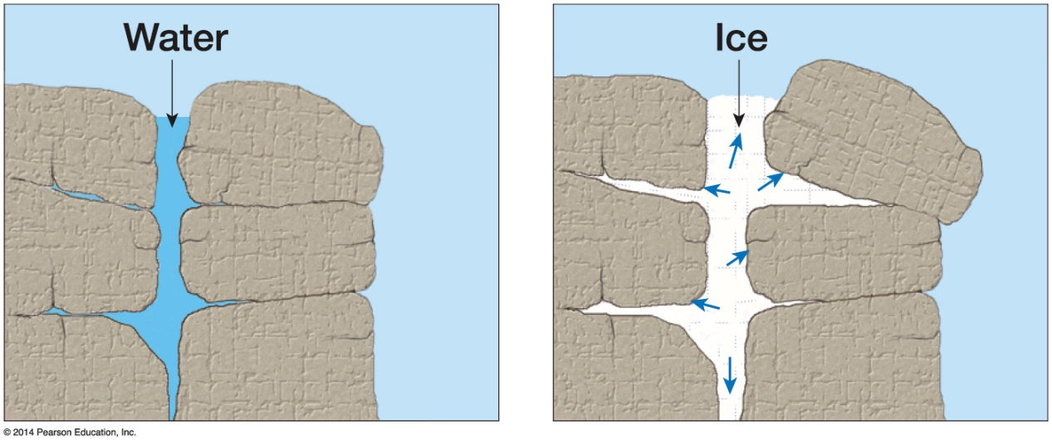

Weathering Agents
Mechanical Weathering
Physical disintegration of rock without changes to its chemical composition
Frost wedging
Freeze–thaw action of water
Ice wedges downward in openings
Ice melts and water falls farther into larger opening
Process repeats
Frost shattering

Slide 6
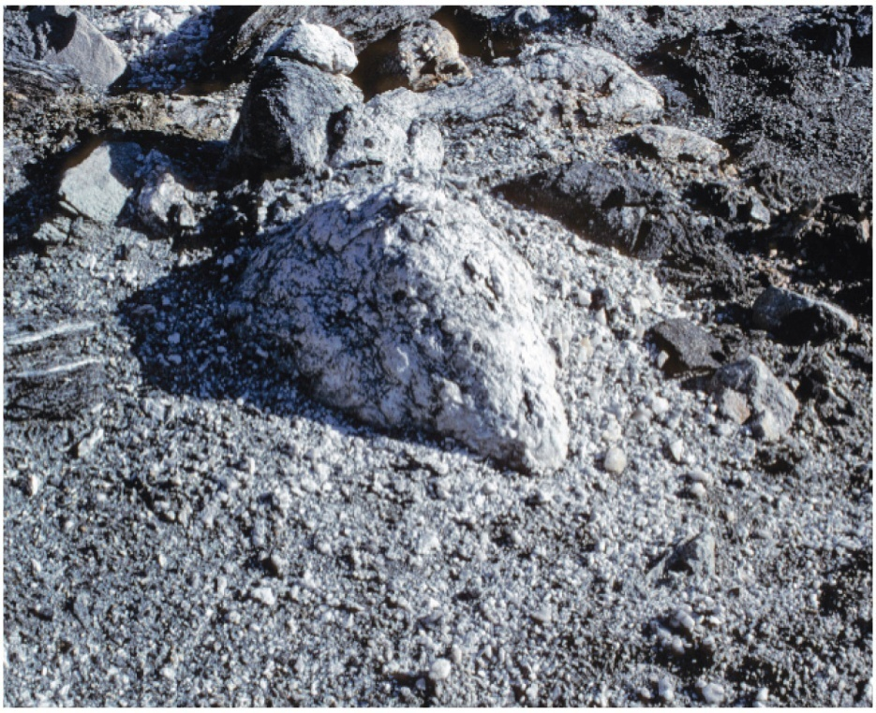

Weathering Agents
Salt wedging
Salt left behind from evaporated water collects and pries apart rock openings

Slide 7
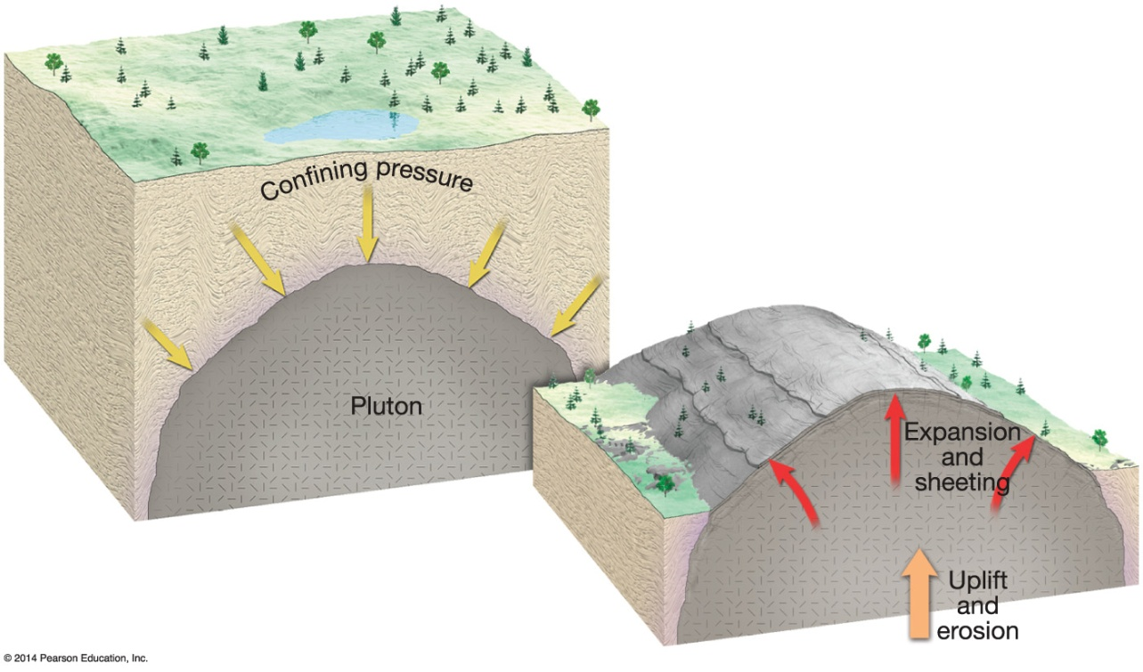
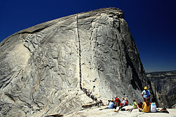

Weathering Agents
Exfoliation
Curved layers peel off of bedrock
Exfoliation dome
Unloading through erosion
Hydration

Slide 8
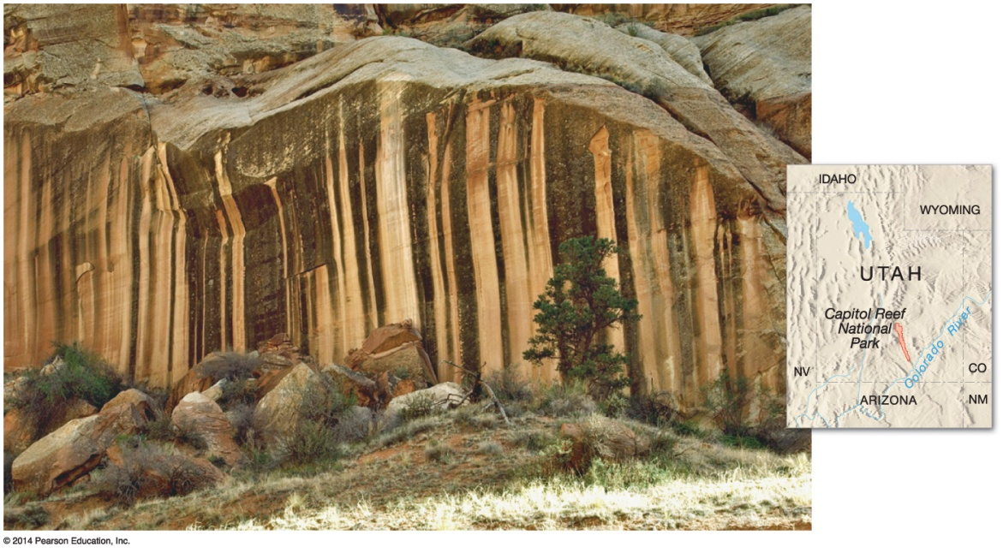

Weathering Agents
Chemical Weathering
Decomposition of rock material through chemical alteration of minerals
Greater surface area is decomposed faster
Moisture required for most processes
Oxidation
Oxygen combined with metallic elements in minerals to form new products
Iron oxide – rusting

Slide 9

Weathering Agents
Hydrolysis
Union of water and another substance to produce a new substance
Igneous rock is particularly susceptible
Carbonation
Reaction between carbon dioxide and carbonate rocks
Less common processes exist as well
Chemically weathered rocks are less coherent and have loose particles

Slide 10
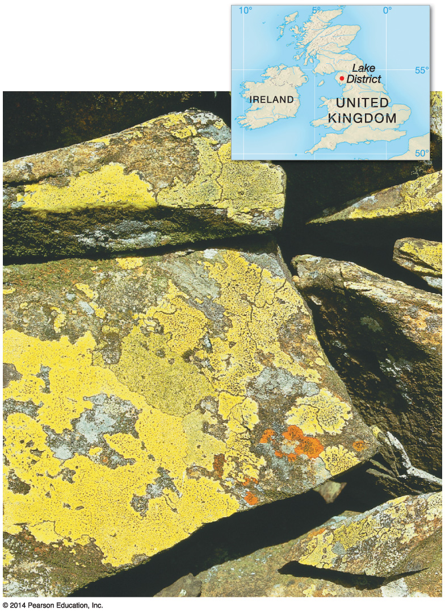

Weathering Agents
Biological weathering
Plants and animals alter rock structure
Impacts of lichens
Burrowing animals
Climate and weathering
High temperatures and abundant precipitation increase chemical weathering

Slide 11
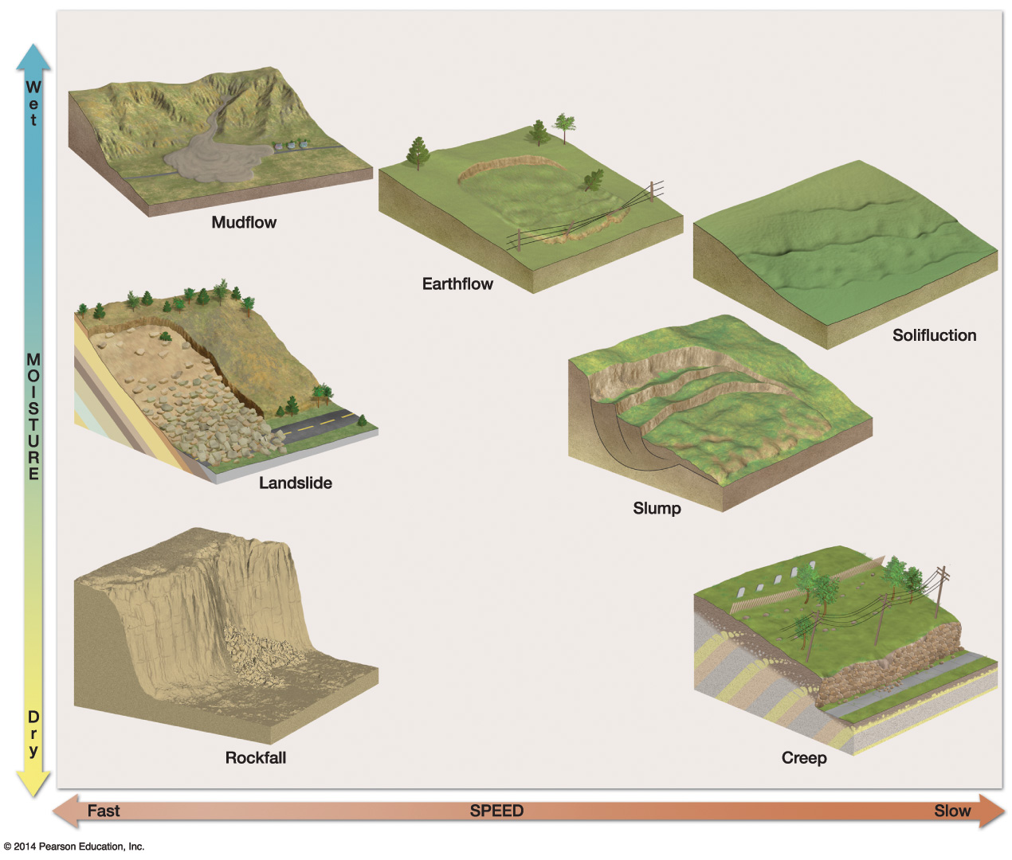

Mass Wasting
Types of mass wasting

Slide 12
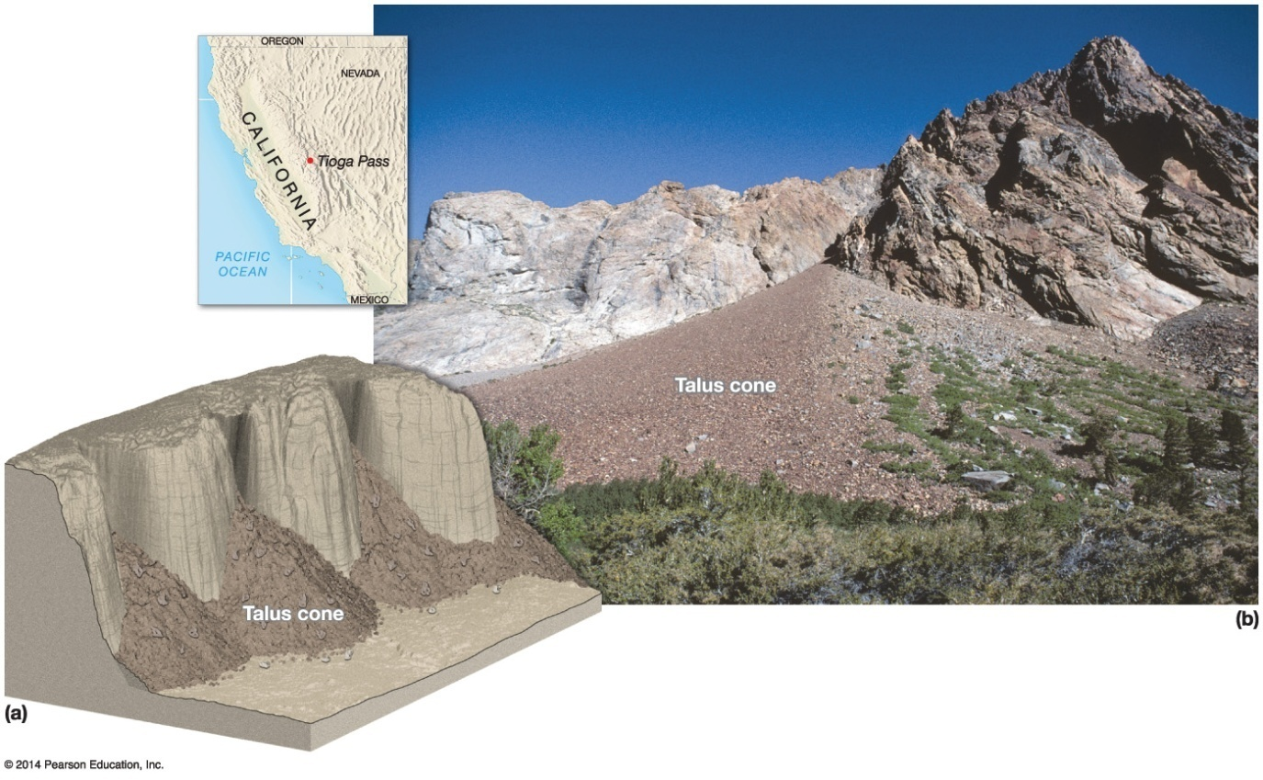

Mass Wasting
Fall
Rockfall
Talus/Scree
Uniform accumulation of rockfall material – talus apron
Material tends to collect in cone shaped heaps – talus cones
Talus cones grow up the mountain
Slow talus flow in glaciers – rock glaciers

Slide 13
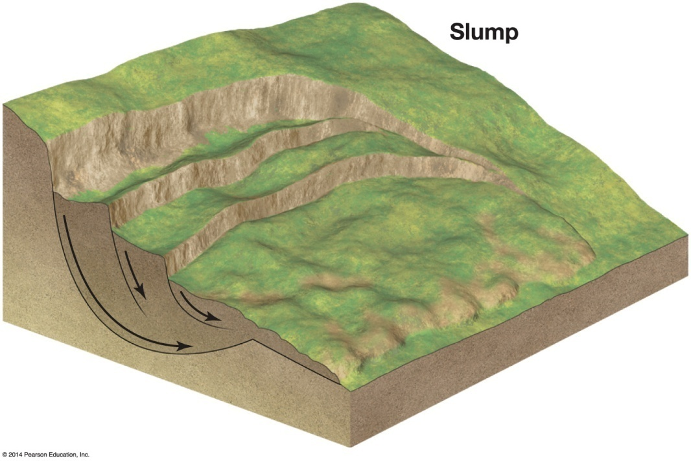

Mass Wasting
Slide
Landslide, instantaneous mass slope collapse with no fluid flow lubrication
Initiated from added weight from rainfall or earthquakes
Rock avalanches
Lost material leaves land scar
Rotation of sliding material – slump

Slide 14
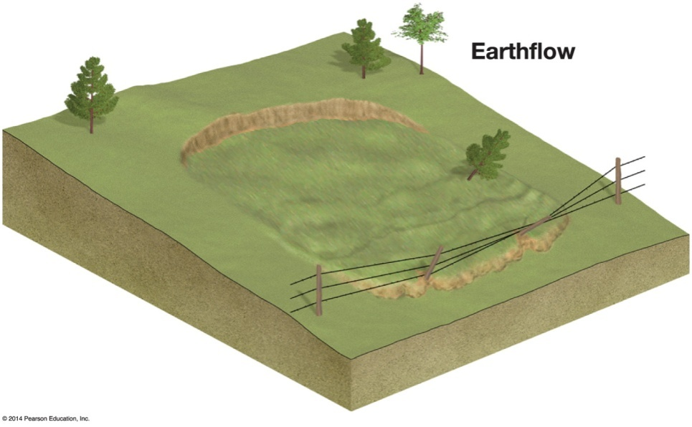
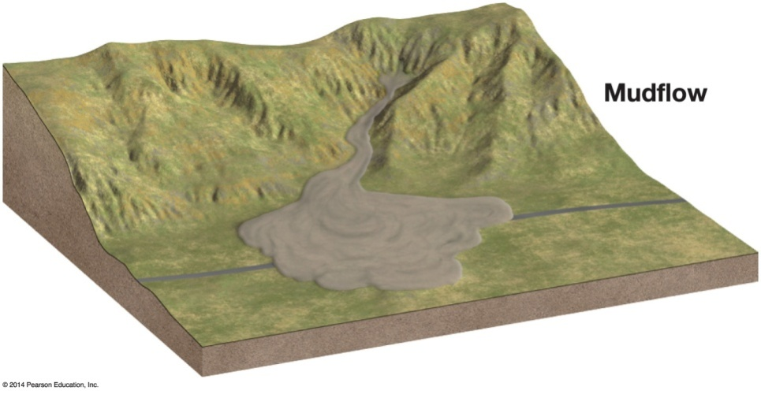

Mass Wasting
Flow
Wasting initiated or enhanced by addition of water
Water primary force; clay can enhance motion as well
Earthflows – water saturated land moved downhill
Mudflows – originate in arid basins; muddy downslope flows that can accumulate large rock material

Slide 15
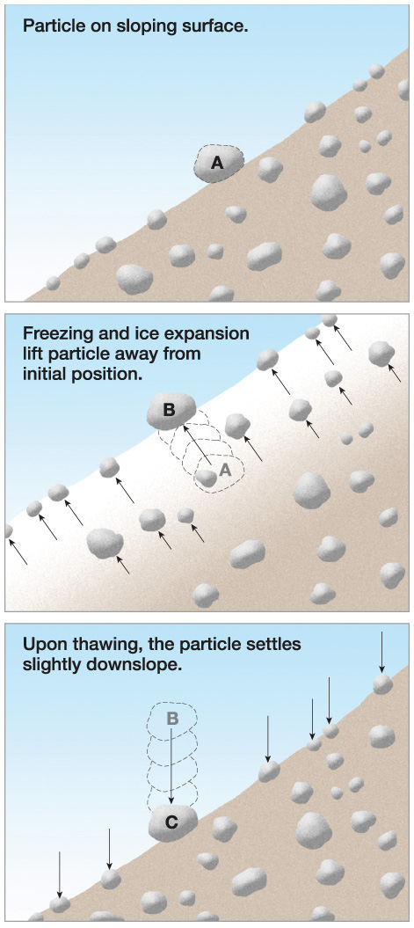
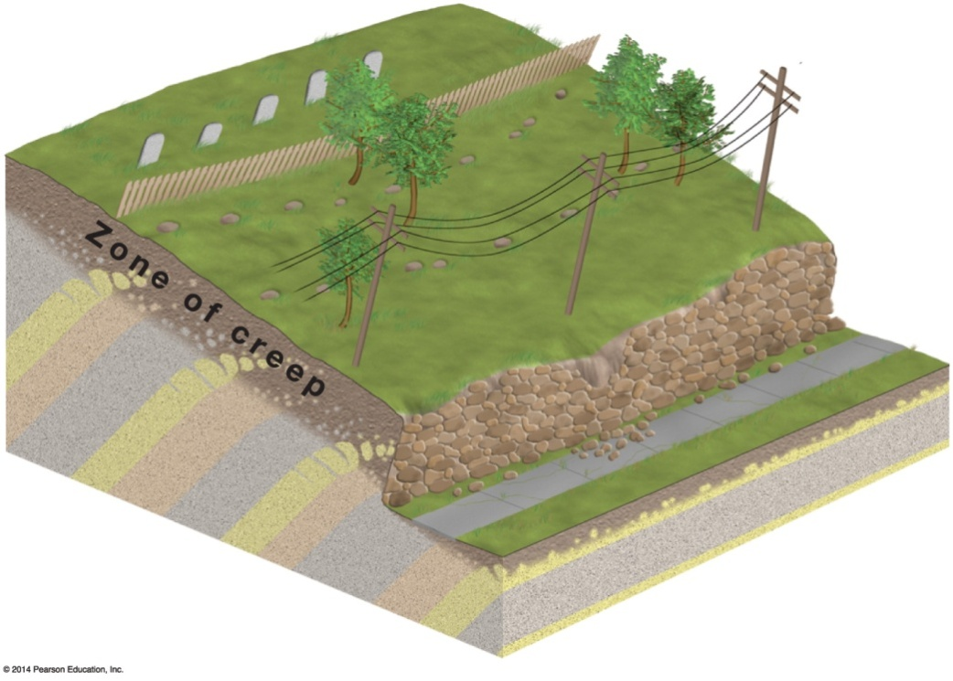

Mass Wasting
Creep
Unobtrusive downslope flow of soil and regolith

Slide 16
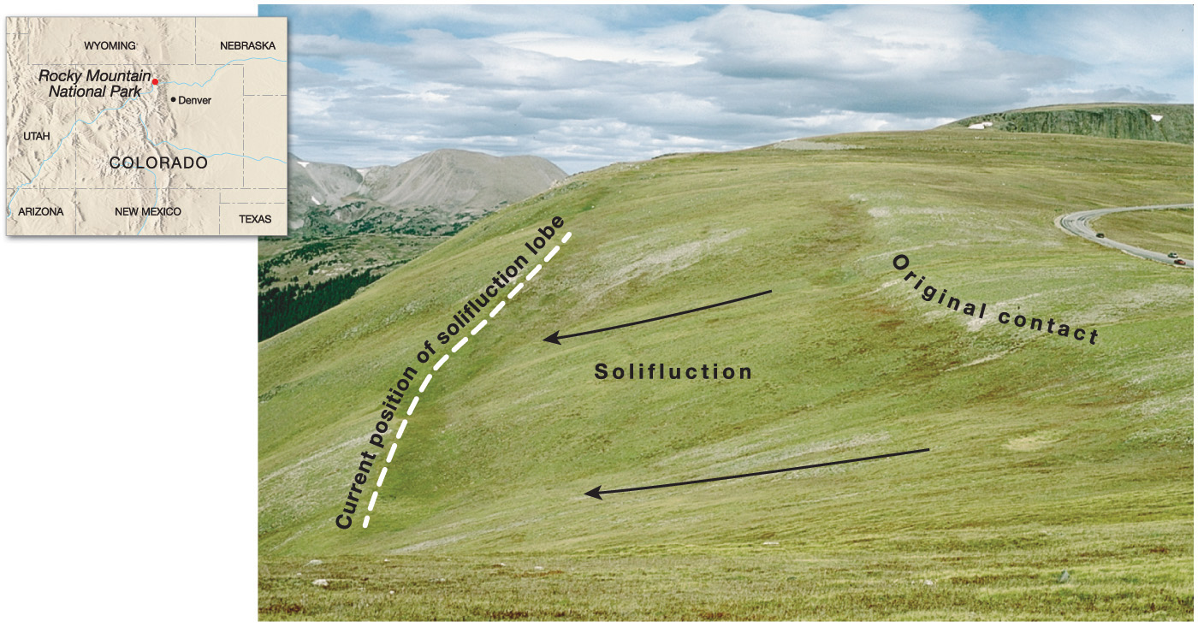

Notes:
Chapter 15, Figure 15.28 Labeled

